Slide 1
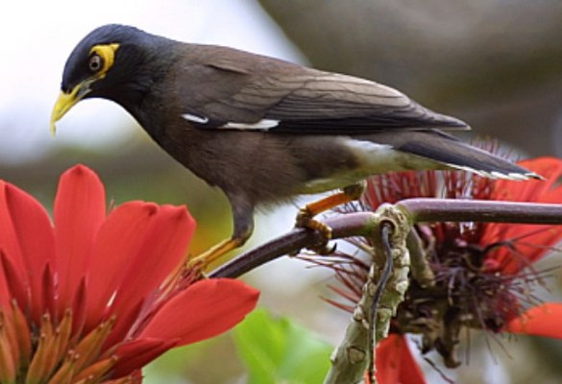
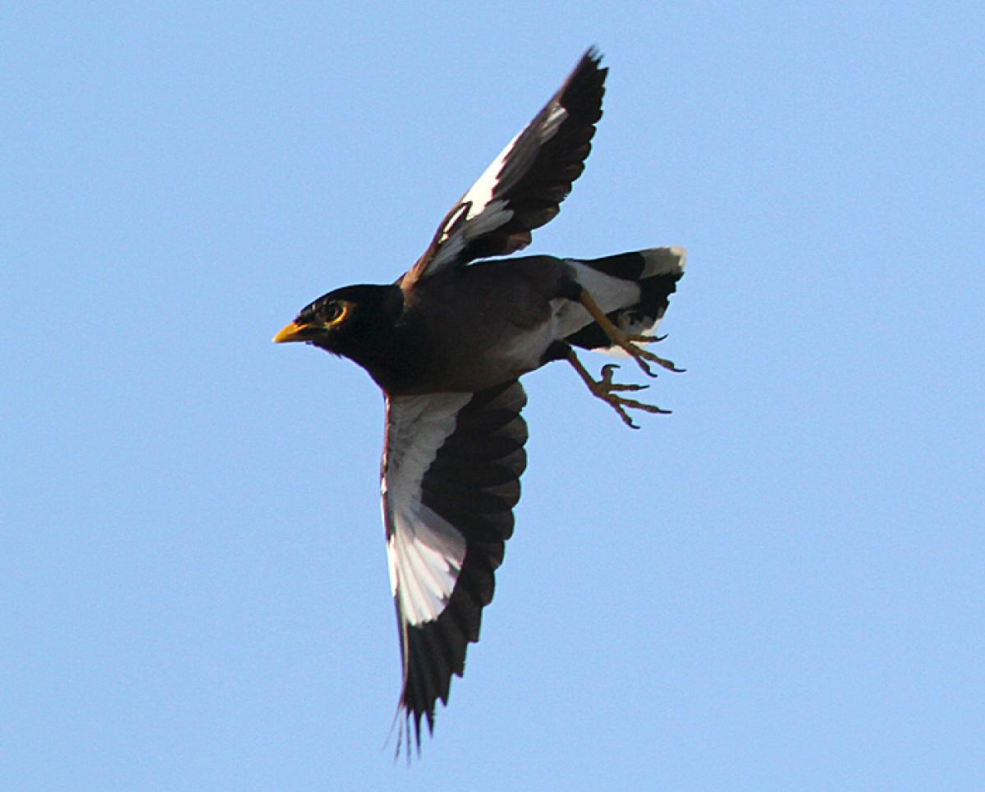
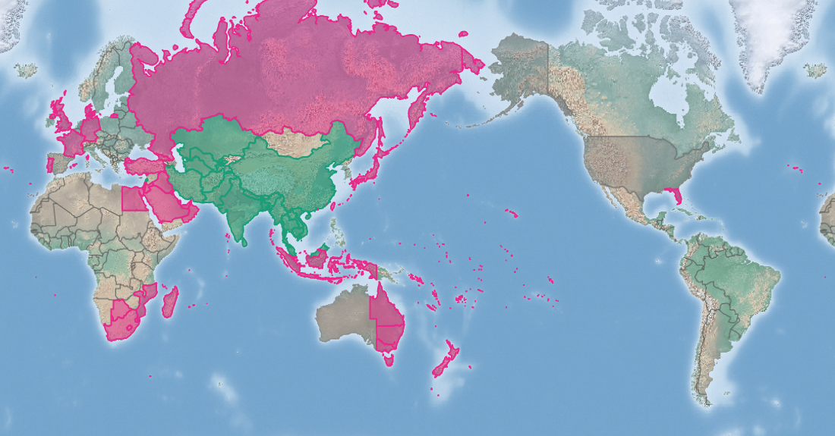
Common myna
Acridotheres tristis*
KEY FEATURES
Approximately 25-26cm in long with a relatively heavy build and a mass of 82-143 g
Body is chocolate-brown, and the head, neck and upper breast of the adult is glossy black, and the undertail coverts, tail tip and the outer feathers are white
Bill, legs and feet are bright yellow, and there is a bright yellow ring around the eye
The iris of the eye is grey in young but in adults the colour varies, with a base colour from grey-brown through brown to red, often with inner and/or outer margins differently coloured within the range of grey-brown to red.
Male and female birds are not clearly different and difficult to tell apart
Have a distinctive walk, rather than a hop, like most birds
Myna have a varied diet. They eat fruits, berries, grains, flower nectar, insects (beetle larvae and adults, caterpillars, worms, flies, snails) and spiders. They also scavenge on street litter and at rubbish dumps, on animal food and waste at farms and on roadkill
Most successful in human-modified habitats
PATHWAYS ✓ shipping ✓ biological control ✓ pet trade
Introduced
Native
Origin not
recorded

Slide 2






Common myna
Acridotheres tristis*
IMPACTS
Environment
Health
Society &
Culture
Economy
Competes with small mammals and birds for nesting hollows. Preys on other birds' eggs and chicks, and sometimes attacks adults of small birds. A threat to native animals, especially on islands. Carrier of Avian malaria
Large numbers roosting on roofs can potentially contaminate water supplies. Can carry bird mites that can cause dermatitis, asthma, severe irritation and rashes. Can carry arboviruses that an be transmitted to people through insect bites
Not reported, but impacts on native animals will have flow-on cultural impacts if these species are of cultural importance
Flocks can damage fruit crops, including papaya, mangoes, bananas, carambole (star fruit), java apple, golden apple, tomato, chilli and other cultivated fruits
DISTRIBUTION
Native range Central and southern Asia throughout India, Afghanistan, Turkestan, Bangladesh, Sri Lanka, southern China and Indochina, with signs of natural spread to Iran and north into southern Russian states and former Soviet countries
Introduced range Parts of South East Asia, New Zealand, eastern Australia, southern Africa and Madagascar, many islands in the Atlantic and Indian Oceans, Fiji, Tonga, Wallis and Fortuna, New Caledonia, Tokelau, (extinct) Solomon Islands, Samoa, Cook Islands, French Polynesia
ADDITIONAL NOTES
*On Fiji, Tonga, Samoa, Kiribati and Wallis and Furtuna the closely related jungle myna (Acridotheres fuscus) is also present. Also called Indian myna, and sometimes spelled mynah. The jungle myna is not as widely distributed as the common myna. The jungle myna is dark grey but paler below, its bill is more orange with a bluish base. Jungle myna has a very yellow eye and a tuft of forehead feathers
INFORMATION SOURCES (click links for more)
Images © KW Bridges/University of Hawai’i via CABI (top) © Image © Ormond Torr via https://nzbirdsonline.org.nz/species/common-myna (bottom)
Text and map Acridotheres tristis (common myna) – CABI https://www.cabi.org/isc/datasheet/2994

